Slide 1


Slide 2

1
WHAT IS ECONOMICS?
Notes:
Notes and teaching tips: 5, 7, 16, 18, 19, 27, 31, 35, and 37.
To view a full-screen figure during a class, click the expand button.
To return to the previous slide, click the shrink button.
To advance to the next slide, click anywhere on the full screen figure.
Applying the principles of economics to interpret and understand the news is a major goal of the principles course. You can encourage your students in this activity by using the features called Economics in the News.
(1) Before each class, scan the news and select two or three headlines that are relevant to your session today. There is always something that works. Read the headline and ask for comments, interpretation, discussion. Pose questions arising from it that motivate today’s class. At the end of the class, return to the questions and answer them with the tools you’ve been explaining.
(2) Once or twice a semester, set an assignment, for credit, with the following instructions:
(a) Find a news article about an economic topic that you find interesting.
(b) Make a short bullet-list summary of the article.
(c) Write and illustrate with appropriate graphs an economic analysis of the key points in the article.
Use the Economics in the News features in your textbook as models.

Slide 3
After studying this chapter, you will be able to:
Define economics and distinguish between microeconomics and macroeconomics
Explain the two big questions of economics
Explain the key ideas that define the economic way of thinking
Explain how economists go about their work as social scientists and policy advisers
Describe the jobs available for an economics major

Slide 4
Definition of Economics
All economic questions arise because we want more than we can get.
Our inability to satisfy all our wants is called scarcity.
Because we face scarcity, we must make choices.
The choices we make depend on the incentives we face.
An incentive is a reward that encourages an action or a penalty that discourages an action.

Slide 5
Definition of Economics
Economics is the social science that studies the choices that individuals, businesses, governments, and entire societies make as they cope with scarcity and the incentives that influence and reconcile those choices.
Economics divides in two main parts:
Microeconomics
Macroeconomics
Notes:
No definition of economics can adequately capture the subject. For that reason, some teachers don’t like definitions and skip right over them. If you are one of these teachers, go ahead. Not much is lost.
Other teachers regard a basic definition as essential, and the textbook takes this view. The definition in the text…“the social science that studies the choices that individuals, businesses, and governments, and entire societies make as they cope with scarcity,” is a modern language version of Lionel Robbins famous definition, “Economics is the science which studies human behavior as a relationship between ends and scarce means that have alternative uses.”
Some teachers like to play with definitions a bit more elaborately. If you are one of these, here are four more, all of which add some useful insight and the last one a bit of fun:
John Maynard Keynes: “The theory of economics does not furnish a body of settled conclusions immediately applicable to policy. It is a method rather than a doctrine, an apparatus of the mind, a technique of thinking, which helps its possessors to draw correct conclusions.”
Alfred Marshall: “Economics is a study of mankind in the ordinary business of life; it examines that part of individual and social action which is most closely connected with the attainment and with the use of the material requisites of wellbeing.”
Jacob Viner: “Economics is what economists do.”
Jim Duesenberry: “Economics is all about how people make choices. Sociology is about why there isn’t any choice to be made.”

Slide 6
Definition of Economics
Microeconomics is the study of choices that individuals and businesses make, the way those choices interact in markets, and the influence of governments.
An example of a microeconomic question is: Why are people downloading more movies? Would a tax on downloads change the number of movies downloaded?
Macroeconomics is the study of the performance of the national and global economies.
An example of a macroeconomic question is: Why does the unemployment rate fluctuate?

Slide 7
Two Big Economic Questions
Two big questions summarize the scope of economics:
How do choices end up determining what, how, and for whom goods and services get produced?
When do choices made in the pursuit of self-interest also promote the social interest?
Notes:
Don’t skip the questions in a rush to get to the economic way of thinking. Open your students’ eyes to economics in the world around them. Ask them to bring a newspaper to class and to identify headlines that deal with stories about What, How, and For Whom. Use Economics in the News Today on your Parkin Web site for a current news item and for an archive of past items (with questions). Pose questions and be sure that the students appreciate that they will have a much better handle on questions like these when they’ve completed their economics course.

Slide 8
Two Big Economic Questions
What, How, and For Whom?
Goods and services are the objects that people value and produce to satisfy human wants.
What?
In the United States, agriculture accounts for less than 1 percent of total production, manufactured goods for 19 percent, and services for 80 percent.
In low-income Ethiopia, agriculture accounts for 36 percent of total production, manufactured goods for 17 percent, and services for 47 percent.

Slide 9
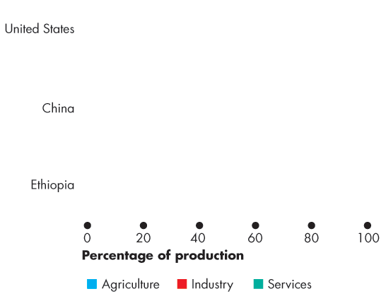
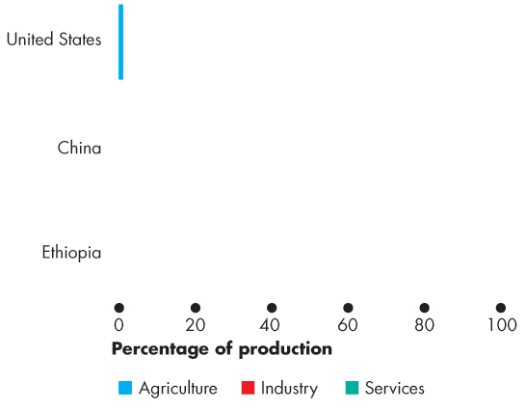
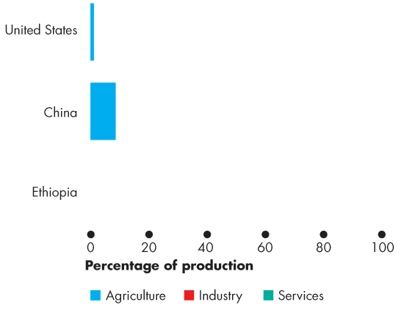
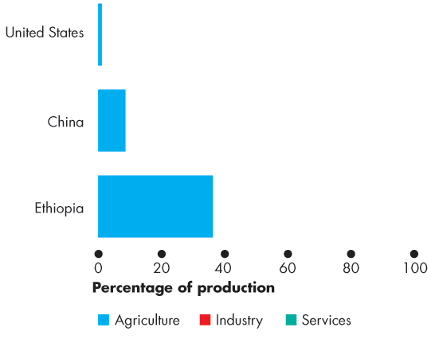
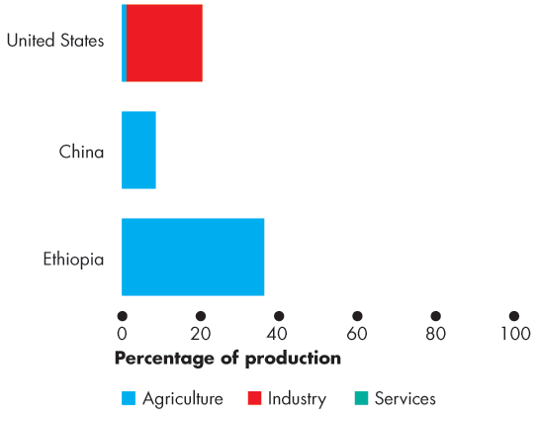
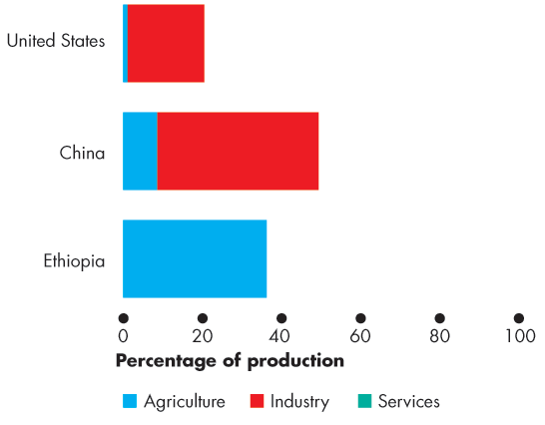
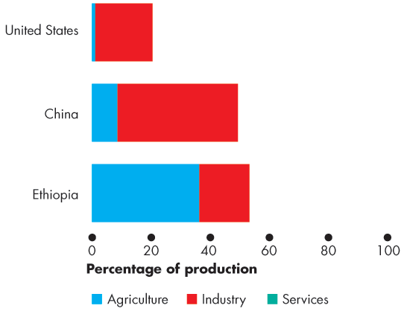
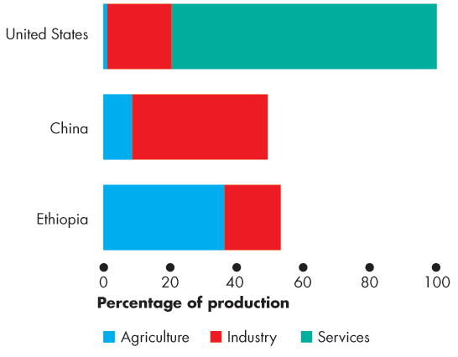
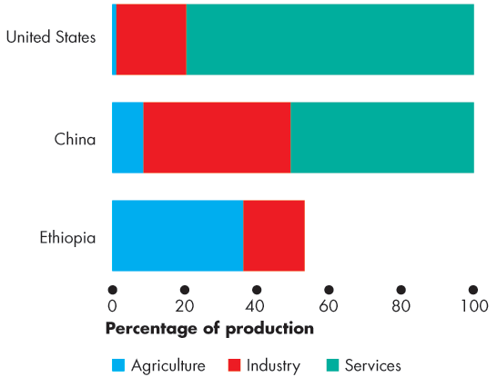
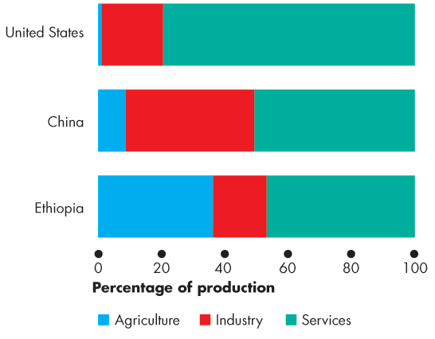

Two Big Economic Questions
Figure 1.1 shows these numbers for the United States, China, and Ethiopia.
What determines these patterns of production?
How do choices end up determining the quantity of each item produced in the United States and around the world?

Slide 11
Two Big Economic Questions
How?
Goods and services are produced by using productive resources that economists call factors of production.
Factors of production are grouped into four categories:
Land
Labor
Capital
Entrepreneurship

Slide 12
Two Big Economic Questions
The “gifts of nature” that we use to produce goods and services are land.
The work time and work effort that people devote to producing goods and services is labor.
The quality of labor depends on human capital, which is the knowledge and skill that people obtain from education, on-the-job training, and work experience.
The tools, instruments, machines, buildings, and other constructions that businesses use to produce goods and services are capital.
The human resource that organizes land, labor, and capital is entrepreneurship.

Slide 13
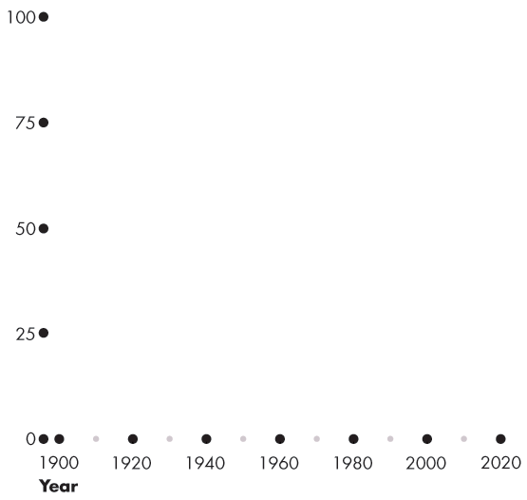
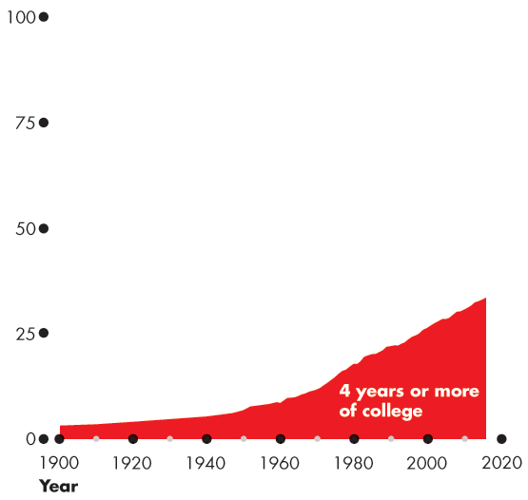
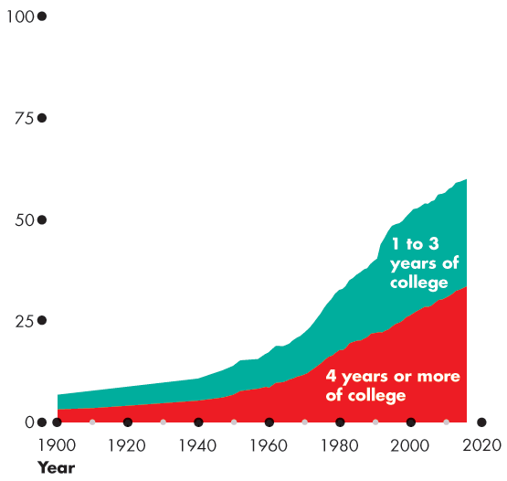
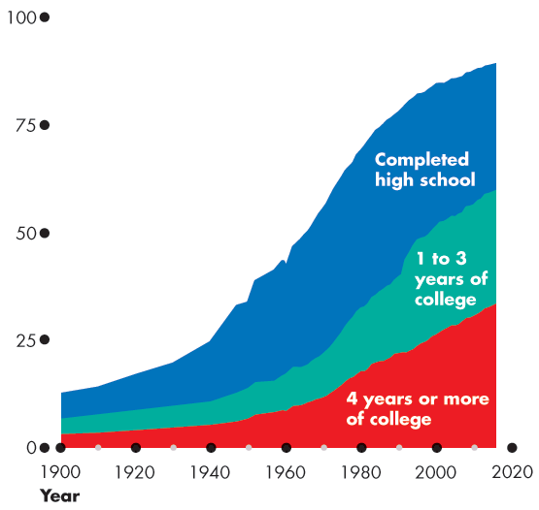
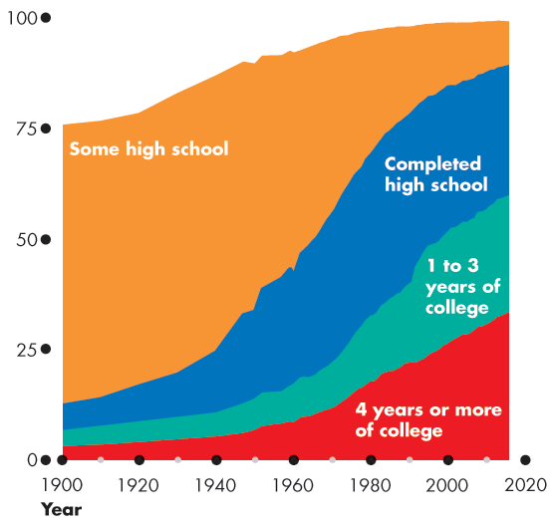
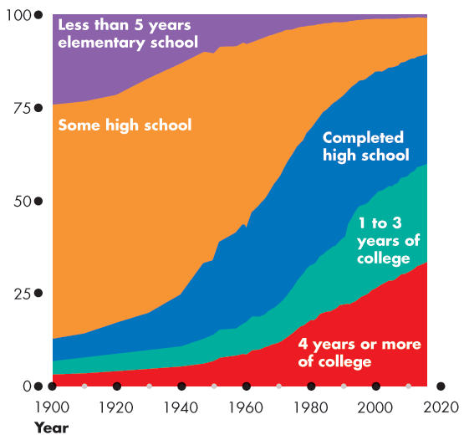
Two Big Economic Questions
Figure 1.2 shows a measure of the growth of human capital in the United States since 1900—the percentage of the population that has completed different levels of education.
Economics explains these trends.

Slide 15
Two Big Economic Questions
For Whom?
Who gets the goods and services depends on the incomes that people earn.
Land earns rent.
Labor earns wages.
Capital earns interest.
Entrepreneurship earns profit.

Slide 16
Two Big Economic Questions
Do Choices Made in the Pursuit of Self-Interest also Promote the Social Interest?
Every day, 325 million Americans and 7.4 billion people in other countries make economic choices that result in what, how, and for whom goods and services are produced.
These choices are made by people who are pursuing their self-interest.
Are they promoting the social interest?
Notes:
Classroom activity
Check out the AT Issue: The Protest Against Market Capitalism”
Checkout Economics in the News: The Invisible Hand
Check out Economics in the News: The Internet for Everyone

Slide 17
Two Big Economic Questions
Self-Interest
You make choices that are in your self-interest—choices that you think are best for you.
Social Interest
Choices that are best for society as a whole are said to be in the social interest.
Social interest has two dimensions: efficiency and fair shares.

Slide 18
Two Big Economic Questions
Efficiency and Social Interest
Resource use is efficient if it is not possible to make someone better off without making someone else worse off.
Fair Shares and Social Interest
The idea that the social interest requires “fair shares” is a deeply held one.
But what is a fair share?
Notes:
Talk about Adam Smith and the Wealth of Nations.
Note that this book was the first systematic attempt to address this big question and that economists have been trying to answer it ever since.
You might like to mention that several Nobel Prizes have been awarded to economists who have worked on the question including Ken Arrow, John Hicks, and Gerard Debreu, as well as John Nash of “Beautiful Mind” fame.

Slide 19
Two Big Economic Questions
Questions about the social interest are hard ones to answer and they generate discussion, debate, and disagreement.
Four topics that generate discussion and that illustrate tension between self-interest and social interest are:
Globalization
Information-age monopolies
Climate change
Financial instability
Notes:
There is not much that we can say to our students at this early point in the course about the way we try to describe the tension between self-interest and the social interest demonstrated by these topics. We can raise the interest level and excitement about the economics course by talking about issues like these four. The Boxes in the textbook flush out the topics.
Talk about some of these and any others that you happen to know a decent amount about. Try very hard to turn your students on! Get them debating these issues and try to steer the discussion toward benefits, costs, and who receives and bears them.

Slide 20
Two Big Economic Questions
Globalization
Globalization means the expansion of international trade, borrowing and lending, and investment.
Globalization is in the self-interest of consumers who buy low-cost imported goods and services.
Globalization is also in the self-interest of the multinational firms that produce in low-cost regions and sell in high-price regions.
But is globalization in the self-interest of low-wage workers in other countries and U.S. firms that can’t compete with low-cost imports?
Is globalization in the social interest?

Slide 21
Two Big Economic Questions
Information-Age Monopolies
The technological change of the past forty years has been called the Information Revolution.
The information revolution has clearly served your self-interest: It has provided your cell-phone, laptop, loads of handy applications, and the Internet.
It has also served the self-interest of Bill Gates of Microsoft and Gordon Moore of Intel, both of whom have seen their wealth soar.
But did the information revolution serve the social interest?

Slide 22
Two Big Economic Questions
Climate Change
Climate change is a huge political issue today.
Every serious political leader is acutely aware of the problem and of the popularity of having proposals that might lower carbon emissions.
Burning fossil fuels to generate electricity and to power airplanes, automobiles, and trucks pours a staggering 28 billion tons—4 tons per person—of carbon dioxide into the atmosphere each year.

Slide 23
Two Big Economic Questions
Two thirds of the world’s carbon emissions comes from the United States, China, the European Union, Russia, and India.
The fastest growing emissions are coming from India and China.
The amount of global warming caused by economic activity and its effects are uncertain, but the emissions continue to grow and pose huge risks.

Slide 24
Two Big Economic Questions
Every day, when you make self-interested choices to use electricity and gasoline, you contribute to carbon emissions.
You leave your carbon footprint.
You can lessen your carbon footprint by walking, riding a bike, taking a cold shower, or planting a tree.
But can each one of us be relied upon to make decisions that affect the Earth’s carbon-dioxide concentration in the social interest?
Can governments change the incentives we face so that our self-interested choices are also in the social interest?

Slide 25
Two Big Economic Questions
Economic Instability
In 2008, banks were in trouble. They had made loans that borrowers couldn’t repay and they were holding securities the values of which had crashed.
Banks’ choices to take deposits and make loans are made in self-interest, but does this lending and borrowing serve the social interest?
Do banks lend too much in the pursuit of profit?

Slide 26
Economic Way of Thinking
Six key ideas define the economic way of thinking:
A choice is a tradeoff.
People make rational choices by comparing benefits and costs.
Benefit is what you gain from something.
Cost is what you must give up to get something.
Most choices are “how-much” choices made at the margin.
Choices respond to incentives.

Slide 27
Economic Way of Thinking
A Choice Is a Tradeoff
The economic way of thinking places scarcity and its implication, choice, at center stage.
You can think about every choice as a tradeoff—an exchange—giving up one thing to get something else.
On Saturday night, will you study or have fun?
You can’t study and have fun at the same time, so you must make a choice.
Whatever you choose, you could have chosen something else. Your choice is a tradeoff.
Notes:
Begin by encouraging the students to use the economic way of thinking to reflect on their own lives.
Why are you here in college? Ask the students why they are pursuing a university degree. Most of them will say that they want a good paying job. Tell them about jobs such as postal workers, long haul truck drivers or grocery clerks that require relatively little training and offer up to $30,000 a year plus benefits. Ask the students to calculate the opportunity cost of being in school. Most students are shaken when they realize that the opportunity cost of a college degree approaches $150,000 to $200,000. Don’t leave them hanging here though. Mention that a college education does yield a high rate of return and suggest that they return to this topic when they get through Chapter 2.

Slide 28
Economic Way of Thinking
Making a Rational Choice
A rational choice is one that compares costs and benefits and achieves the greatest benefit over cost for the person making the choice.
Only the wants of the person making a choice are relevant to determine its rationality.
The idea of rational choice provides an answer to the first question: What goods and services will be produced and in what quantities?
The answer is: Those that people rationally choose to buy!

Slide 29
The Economic Way of Thinking
How do people choose rationally?
The answers turn on benefits and costs.
Benefit: What you Gain
The benefit of something is the gain or pleasure that it brings and is determined by preferences
Preferences are what a person likes and dislikes and the intensity of those feelings.

Slide 30
The Economic Way of Thinking
Cost: What you Must Give Up
The opportunity cost of something is the highest-valued alternative that must be given up to get it.
What is your opportunity cost of going to a live concert?
Opportunity cost has two components:
1. The things you can’t afford to buy if you purchase the concert ticket.
2. The things you can’t do with your time if you attend the concert.

Slide 31
The Economic Way of Thinking
How Much? Choosing at the Margin
You can allocate the next hour between studying and instant messaging your friends.
The choice is not all or nothing, but you must decide how many minutes to allocate to each activity.
To make this decision, you compare the benefit of a little bit more study time with its cost—you make your choice at the margin.
Notes:
Will your tradeoffs improve? You can do your student’s a further favor by helping them to realize that the tradeoffs they face today are as favorable as they will ever be. It’s an old cliché, but effective, to remind them that they are not going to be any more attractive than they are now, nor are they going to gain any additional physical prowess or have any greater capacity to learn than they have at this very moment in their lives. Right now they could do almost anything they set their minds to do. Encourage the students to figure out and be utterly convinced that the benefits they receive from being in college exceed the large opportunity cost that scarcity forces them to bear. Remind them of the relevance of this cost-benefit calculation to their decisions to skip classes, not study for exams, or retake core courses and delay graduation.
Scarcity Versus Poverty Ask the students why they haven’t yet attained all of their personal goals. One reason will be that they lack sufficient money. Ask them if they could attain all of their goals if they were as rich as Bill Gates. They quickly realize that time is a big constraint. They have stumbled on the fact that scarcity, which even Bill Gates faces, is not poverty. You can emphasize this distinction.

Slide 32
The Economic Way of Thinking
To make a choice at the margin, you evaluate the consequences of making incremental changes in the use of your time.
The benefit from pursuing an incremental increase in an activity is its marginal benefit.
The opportunity cost of pursuing an incremental increase in an activity is its marginal cost.
If the marginal benefit from an incremental increase in an activity exceeds its marginal cost, your rational choice is to do more of that activity.

Slide 33
The Economic Way of Thinking
Choices Respond to Incentives
A change in marginal cost or a change in marginal benefit changes the incentives that we face and leads us to change our choice.
The central idea of economics is that we can predict how choices will change by looking at changes in incentives.
Incentives are also the key to reconciling self-interest and the social interest.

Slide 34
Economics: A Social Science and Policy Tool
Economist as Social Scientist
Economists distinguish between two types of statement:
Positive statements
Normative statements
A positive statement can be tested by checking it against facts.
A normative statement expresses an opinion and cannot be tested.

Slide 35
Economics: A Social Science and Policy Tool
Unscrambling Cause and Effect
The task of economic science is to discover positive statements that are consistent with what we observe in the world and that enable us to understand how the economic world works.
Economists create and test economic models.
An economic model is a description of some aspect of the economic world that includes only those features that are needed for the purpose at hand.
Notes:
The value of models. Help the students to appreciate the power of models as tools for understanding reality. The analogy of a model as a map is easy and convincing. Jim Peach, a fine economics teacher at the University of New Mexico, gets his students to make paper airplanes on the first day of class. After flying their paper planes around the classroom (and picking up the debris!) he gets them to talk about what they can learn about real airplanes from experimenting with paper (and other model) planes.

Slide 36
Economics: A Social Science and Policy Tool
A model is tested by comparing its predictions with the facts.
But testing an economic model is difficult, so economists also use:
Natural experiments
Statistical investigations
Economic experiments

Slide 37
Economics: A Social Science and Policy Tool
Economist as Policy Adviser
Economics is a toolkit for advising governments and businesses and for making personal decisions.
All the policy questions on which economists provide advice involve a blend of the positive and the normative.
Economics can’t help with the normative part—the goal.
But for a given goal, economics provides a method of evaluating alternative solutions—comparing marginal benefits and marginal costs.
Notes:
The success of a model is judged by its ability to predict. Help your student’s appreciate that no matter how appealing or “realistic looking” a model appears to be, it is useless if it fails to predict. And the converse, no matter how abstract or far removed from reality a model appears to be, if it predicts well, it is valuable.
Milton Friedman’s Pool Hall example illustrates the point nicely. Imagine a physicist’s model that predicts where a carefully placed shot of a pool shark would go as he tries to sink the eight ball into the corner pocket. The model would be a complex, trigonometric equation involving a plethora of Greek symbols that no ordinary person would even recognize as representing a pool shot. It certainly wouldn’t depict what we actually see—a pool stick striking a pool cue on a rectangular patch of green felt. It wouldn’t even reflect the thought processes of the pool shark that relies on years of experience and the right “touch.” Yet, constructed correctly, this mathematical model would predict exactly where the cue ball would strike the eight ball, hit opposite the bank, and fall into the corner pocket. (You can easily invent analogous examples from any sport.)

Slide 38
Economists in the Economy
What are the jobs available to an economics major?
Is the number of economics jobs expected to grow or shrink?
How much do economics graduates earn?
What are the skills needed for an economics job?

Slide 39
Economists in the Economy
Jobs for an Economics Major
A major in economics opens the door to the pursuit of a masters or PhD and a career as an economist.
The work of economists varies enormously but it includes collecting and analyzing data on the production and use of resources, goods, and services; predicting future trends; and studying ways of using resources more efficiently.
Economists work in private firms, government, and international organizations.

Slide 40


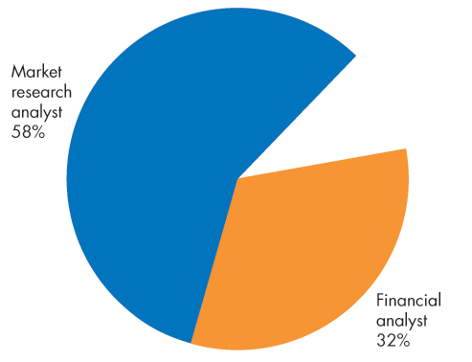
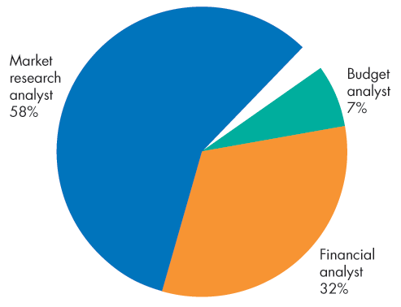
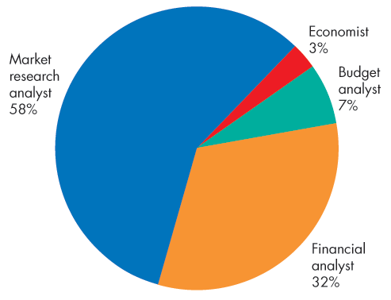
Economists in the Economy
Economics majors also work as market research analysts, financial analysts, and budget analysts.
Figure 1.3 shows the the relative number of jobs for economists and analysts that use economic ideas and tools.

Slide 42
Economists in the Economy
Will Jobs for Economists Grow?
The BLS forecasts that jobs for:
1. Economists with a PhD will grow by 6 percent.
2. Budget analysts will grow by 2 percent.
3. Financial analysts will grow by 12 percent.
4. Market research analysts will grow by 19 percent.

Slide 43
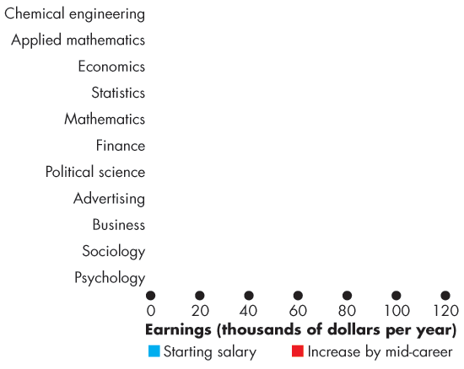
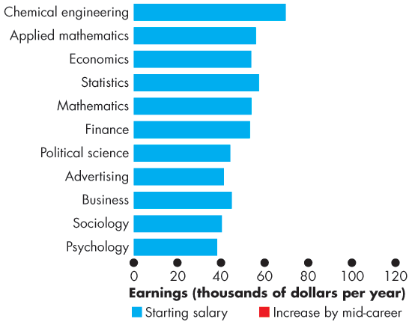
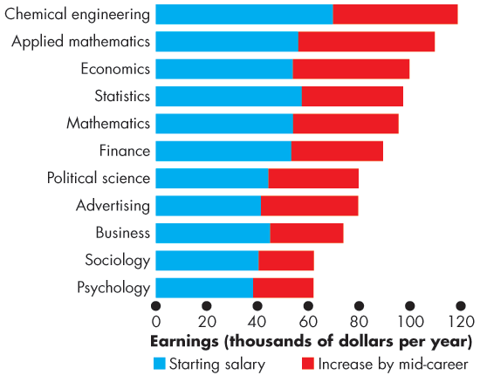
Economists in the Economy
Earnings of Economics Majors
Earnings of economics majors vary a lot depending on the job and their qualifications.
Economists with a PhD would expect to earn about $100,000 a year by mid-career.

Slide 45
Economists in the Economy
Economists working as analysts earn more than the national average.

Slide 46
Economists in the Economy
Skills Needed for Economics Jobs
Employers look for five skills:
1. Critical-thinking skills.
2. Analytical skills
3. Math skills
4. Writing skills
5. Oral communication skills

Slide 47
APPENDIX
Graphs in Economics

Slide 48
After studying this chapter, you will be able to:
Make and interpret a scatter diagram
Identify linear and nonlinear relationships and relationships that have a maximum and a minimum
Define and calculate the slope of a line
Graph relationships among more than two variables

Slide 49
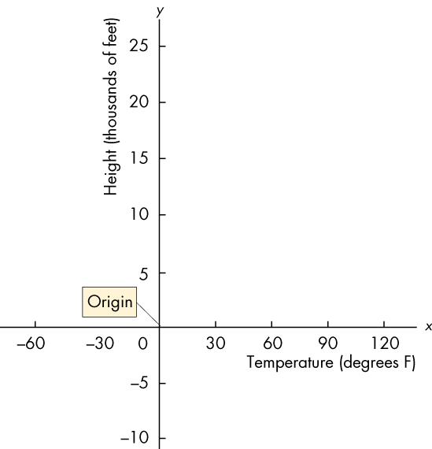
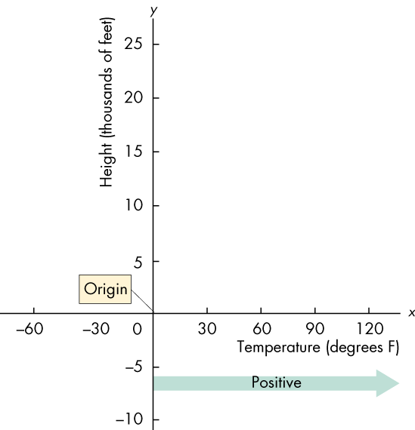
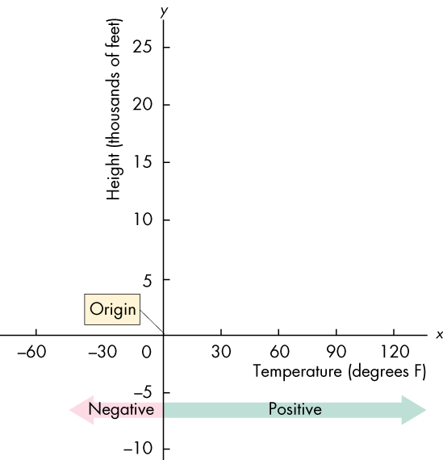
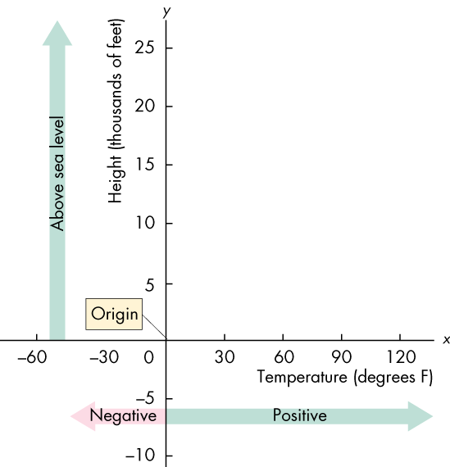
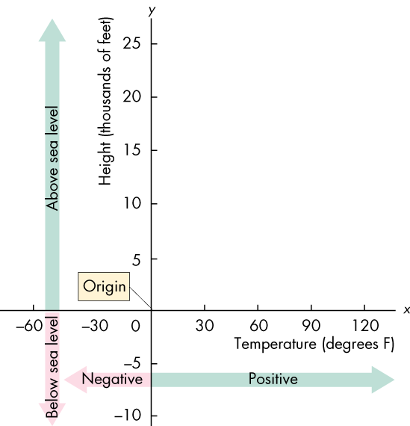
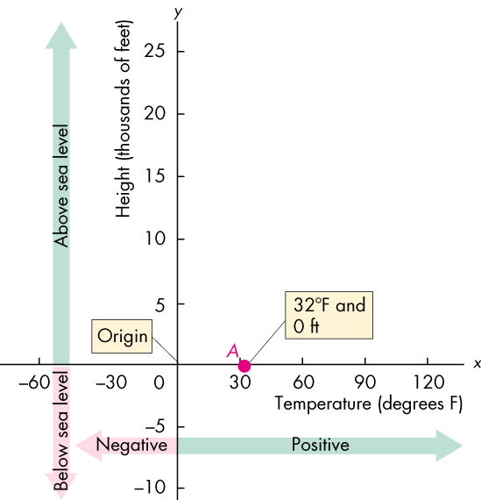
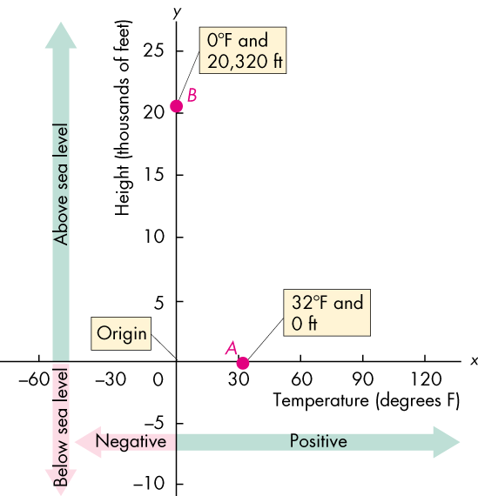
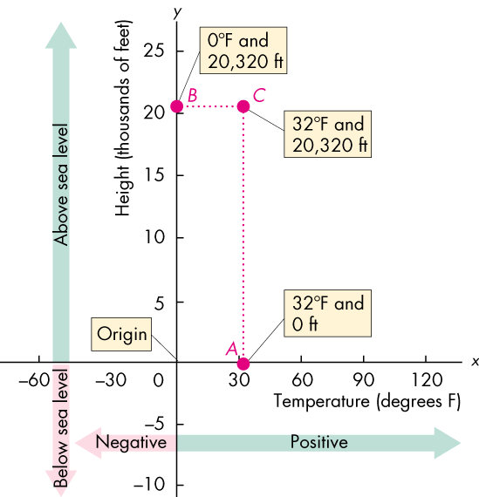
Graphing Data
A graph reveals a relationship.
A graph represents “quantity” as a distance.
A two-variable graph uses two perpendicular scale lines.
The vertical line is the y-axis.
The horizontal line is the x-axis.
The zero point in common to both axes is the origin.

Slide 51
Graphing Data
Economists measure variables that describe what, how, and for whom goods and services are produced.
These variables are quantities produced and prices.
Figure A1.2 shows two examples of economic graphs.

Slide 52
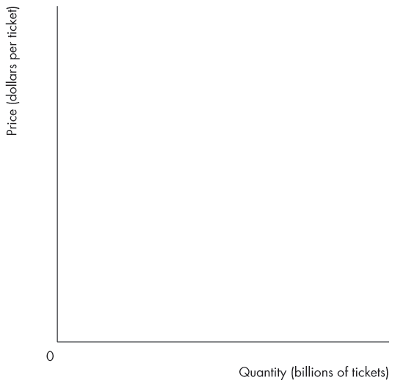
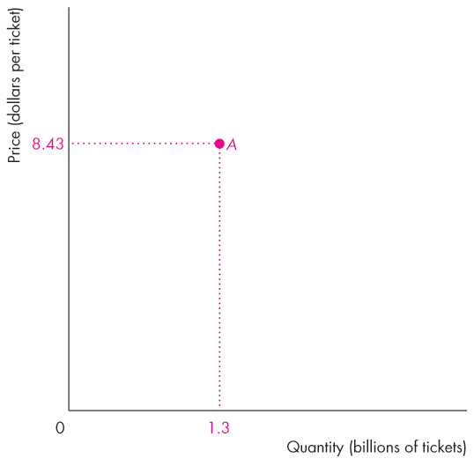
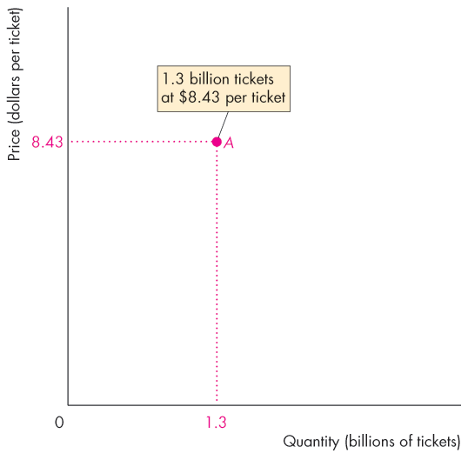
Graphing Data
Figure A1.2 shows how to make an economics graph.
Point A tells us the quantity of tickets bought in 2016 and the average price of a ticket.
You can “read” this graph as telling you that in 2016:
1.3 billion movie tickets were bought at a price of $8.43 a ticket.

Slide 54
Graphing Data
Scatter Diagrams
A scatter diagram plots the value of one variable against the value of another variable for a number of different values of each variable.
A scatter diagram reveals whether a relationship exists between the two variables.
Figure A1.3 shows the production budget for ten popular movies and their worldwide box office revenues.
The table gives the data and the graph describes the relationship between each movie’s production budget and its box office revenue.

Slide 55
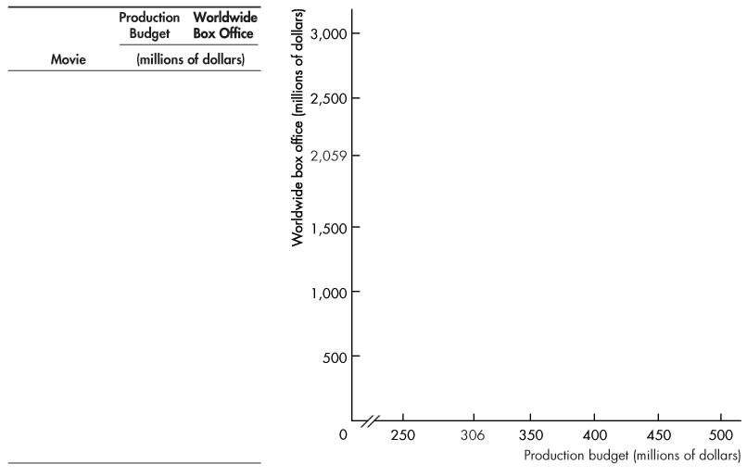
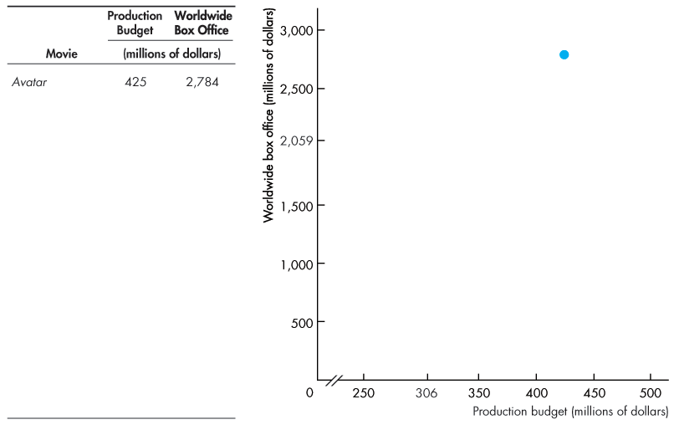
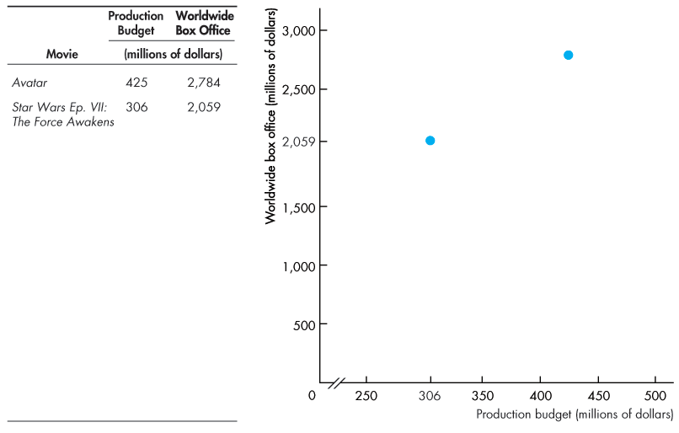
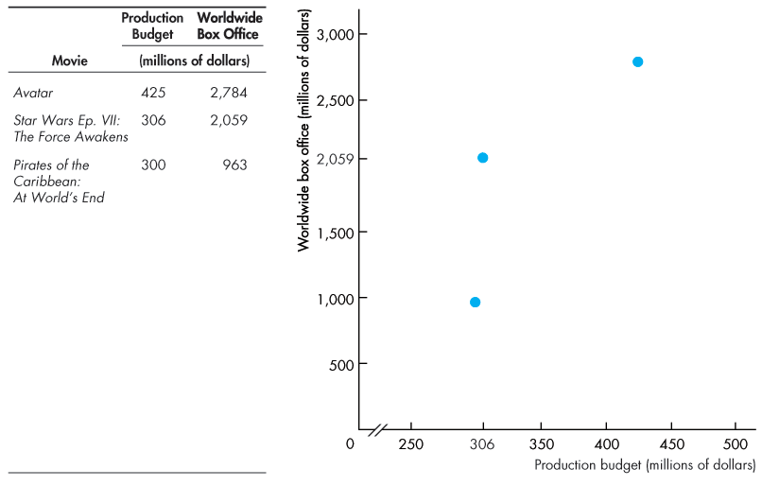
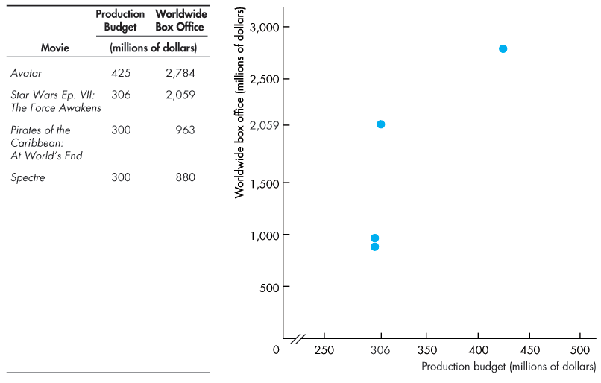
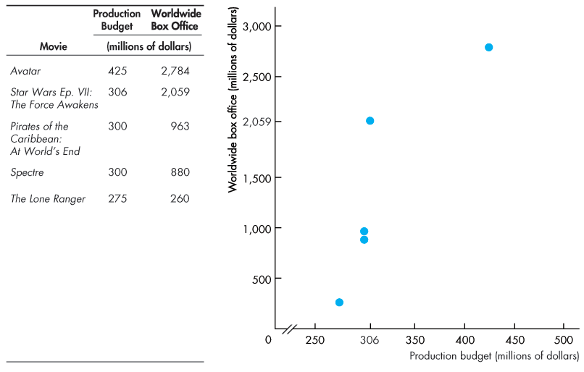
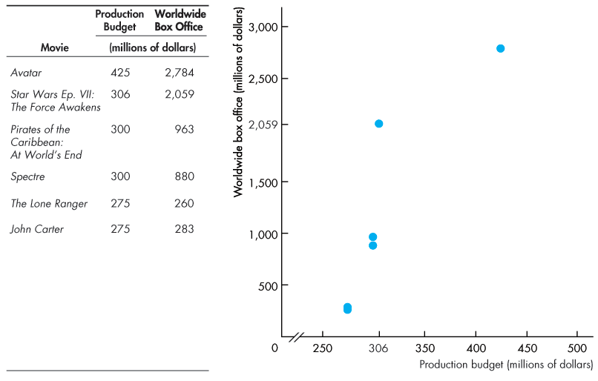
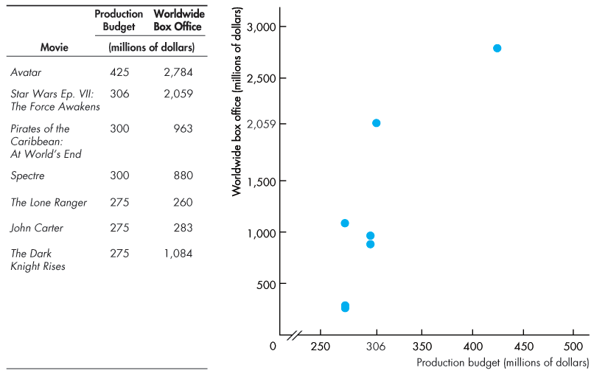
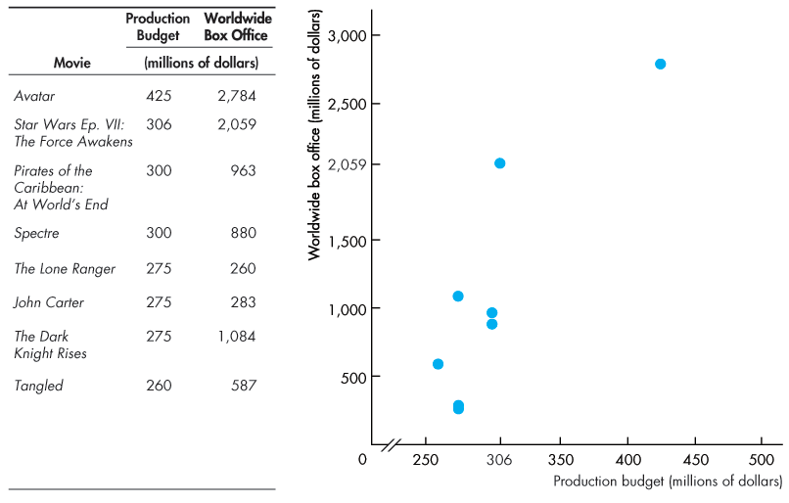
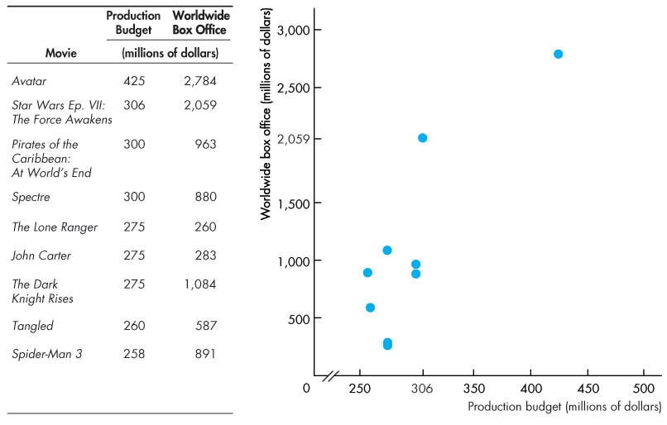
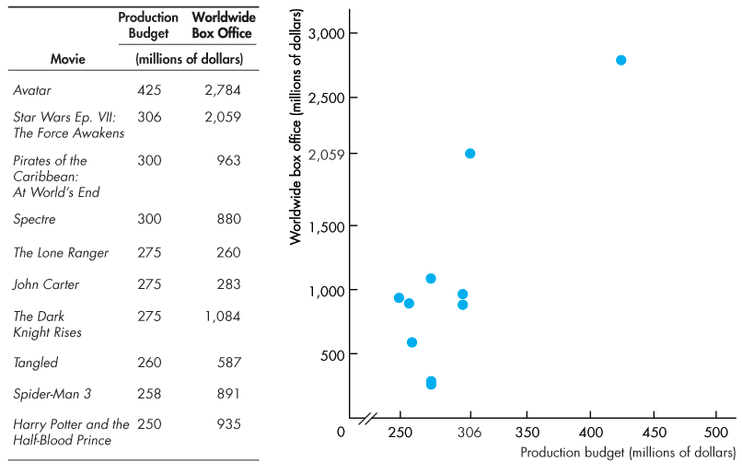
Graphing Data

Slide 56
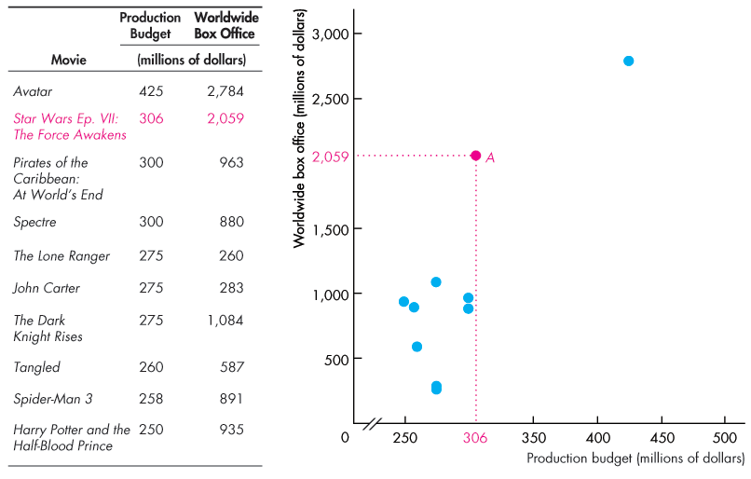
Graphing Data
Point A tells us that Star Wars: The Force Awakens cost $306 million to produce and brought in $2,059 million at the box office.
The pattern of the points reveal that there is no clear tendency for a larger production budget to bring a greater box office revenue.

Slide 58
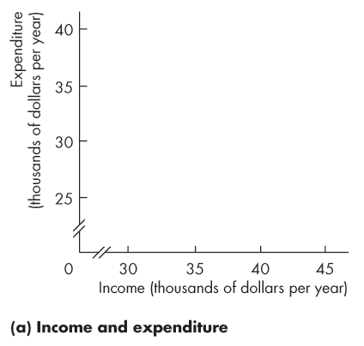
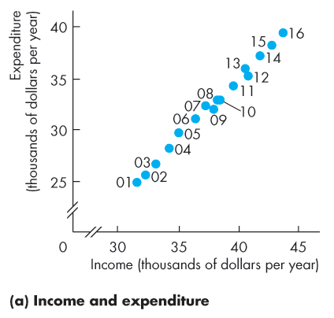
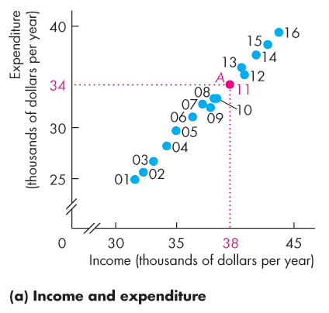
Graphing Data
Figure A1.4(a) is a scatter diagram of income and expenditure, on average, from 2001 to 2016.
Point A shows that in 2011, income was $38,000 and expenditure was $34,000.
The graph shows that as income increases, so does expenditure, and that the relationship is a close one.

Slide 60
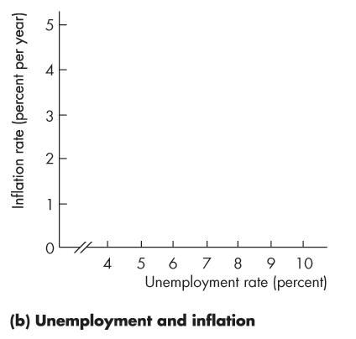
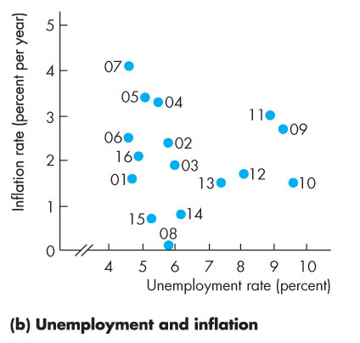
Graphing Data
Figure A1.4(b) is a scatter diagram of inflation and unemployment in the United States from 2001 through.
The points show a weak relationship between the two variables.

Slide 62
Graphs used in Economic Models
Graphs are used in economic models to show the relationship between variables.
The patterns to look for in graphs are the four cases in which
Variables move in the same direction.
Variables move in opposite directions.
Variables have a maximum or a minimum.
Variables are unrelated.

Slide 63
Graphs Used in Economic Models
Variables That Move in the Same Direction
A relationship between two variables that move in the same direction is called a positive relationship or a direct relationship.
A line that slopes upward shows a positive relationship.
A relationship shown by a straight line is called a linear relationship.
The three graphs on the next slide show positive relationships.

Slide 64







Graphs used in Economic Models

Slide 65





Slide 66



Slide 67



Slide 68
Graphs used in Economic Models
Variables That Move in Opposite Directions
A relationship between two variables that move in opposite directions is called a negative relationship or an inverse relationship.
A line that slopes downward shows a negative relationship.
The three graphs on the next slide show negative relationships.

Slide 69







Graphs used in Economic Models

Slide 70



Slide 71



Slide 72



Slide 73
Graphs used in Economic Models
Variables That Have a Maximum or a Minimum
The two graphs on the next slide show relationships that have a maximum and a minimum.
These relationships are positive over part of their range and negative over the other part.

Slide 74






Graphs used in Economic Models

Slide 77
Graphs used in Economic Models
Variables That are Unrelated
Sometimes, we want to emphasize that two variables are unrelated.
The two graphs on the next slide show examples of variables that are unrelated.

Slide 78


Graphs used in Economic Models

Slide 79


Slide 80


Slide 81
The Slope of a Relationship
The slope of a relationship is the change in the value of the variable measured on the y-axis divided by the change in the value of the variable measured on the x-axis.
We use the Greek letter Δ (capital delta) to represent “change in.”
So Δy means the change in the value of the variable measured on the y-axis and Δx means the change in the value of the variable measured on the x-axis.
Slope equals Δy/Δx.

Slide 82







The Slope of a Relationship
The Slope of a Straight Line
The slope of a straight line is constant.
Graphically, the slope is calculated as the “rise” over the “run.”
The slope is positive if the line is upward sloping.

Slide 84







The Slope of a Relationship
The slope is negative if the line is downward sloping.

Slide 86
The Slope of a Relationship
The Slope of a Curved Line
The slope of a curved line at a point varies depending on where along the curve it is calculated.
We can calculate the slope of a curved line either at a point or across an arc.

Slide 87








The Slope of a Relationship
Slope at a Point
The slope of a curved line at a point is equal to the slope of a straight line that is the tangent to that point.
Here, we calculate the slope of the curve at point A.

Slide 89







The Slope of a Relationship
Slope Across an Arc
The average slope of a curved line across an arc is equal to the slope of a straight line that joins the endpoints of the arc.
Here, we calculate the average slope of the curve along the arc BC.

Slide 91
Graphing Relationships Among More Than Two Variables
When a relationship involves more than two variables, we can plot the relationship between two of the variables by holding other variables constant—by using ceteris paribus.
Ceteris paribus
Ceteris paribus means “if all other relevant things remain the same.”
Figure A1.12 shows a relationship among three variables.

Slide 92







Graphing Relationships Among More Than Two Variables
The table gives the quantity of ice cream consumed at different prices as the temperature varies.

Slide 93


Notes:
93

Slide 94
Graphing Relationships Among More Than Two Variables
To plot this relationship we hold the temperature at 70°F.
At $2.75 a scoop, 10 gallons are consumed.

Slide 95
Graphing Relationships Among More Than Two Variables
We can also plot this relationship by holding the temperature constant at 90°F.
At $2.75 a scoop, 20 gallons are consumed.

Slide 96

Graphing Relationships Among More Than Two Variables
When temperature is constant at 70°F and the price of ice cream changes, there is a movement along the blue curve.

Slide 97
Graphing Relationships Among More Than Two Variables
When temperature is constant at 90°F and the price of ice cream changes, there is a movement along the red curve.

Slide 98
Graphing Relationships Among More Than Two Variables
When Other Things Change
The temperature is held constant along each curve, but in reality the temperature can change.

Slide 99
Graphing Relationships Among More Than Two Variables
When the temperature rises from 70°F to 90°F, the curve showing the relationship shifts rightward from the blue curve to the red curve.

